Slide 1


Loan Approval Prediction
Ravindra Neralla
DSC 630

Slide 2
Introduction:
In financial industry, deciding on a loan application, whether to approve or not is a two-edged sword. Bank should not lose business by denying a legitimate customer, who can repay. Also, it should not approve loan to in-eligible customer. Banks are playing important role in challenging times like now, with COVID pandemic across the globe.
Objective:
Primary objective of the analysis is performing data analysis on bank customer dataset and building prediction model, to predict whether a customer loan application would be approved or not.

Slide 3
Variables in Customer Data
Below are the 13 variables present in the dataset.
Loan_ID Unique Loan ID
Gender Male/ Female
Married Applicant married (Y/N)
Dependents Number of dependents
Education Applicant Education (Graduate/ Under Graduate)
Self_Employed Self employed (Y/N)
ApplicantIncome Applicant income
CoapplicantIncome Coapplicant income
LoanAmount Loan amount in thousands
Loan_Amount_Term Term of loan in months
Credit_History credit history meets guidelines
Property_Area Urban/ Semi Urban/ Rural
Loan_Status Loan approved (Y/N)

Slide 4
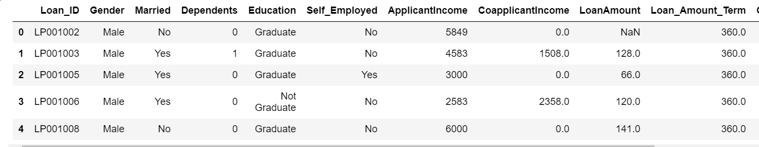
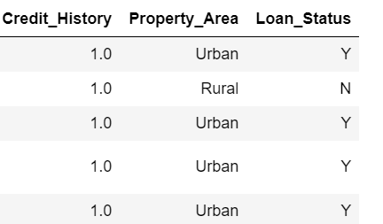
Sample Customer Data

Slide 5
Feature Types
Based on the data present in dataset, features can be divided into below three categories.
Categorical Features:
Based on the data, (Yes/No or Male/Female) below are categorical variables.
Gender, Married, Self_Employed, Credit_History, Loan_Status.
Ordinal Features:
Based on the data with inherent hierarchy, below are ordinal variables.
Dependents, Education and Property_Area
Numerical Features:
Based on the numerical data, below are numerical variables.
ApplicantIncome, Co-applicantIncome, LoanAmount, Loan_Amount_Term

Slide 6
Data Preparation and EDA
Identify and remove if any unwanted variables in the data.
Handle missing values and outliers in the data
Convert categorical variables to numerical for model calculations
Verify the data and if needed perform scaling

Slide 7
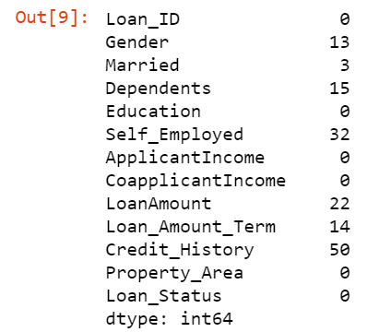
Missing Values in Data
It can be observed that
There are 50 missing values in Credit_History
32 missing values in Self_Employed variable

Slide 8
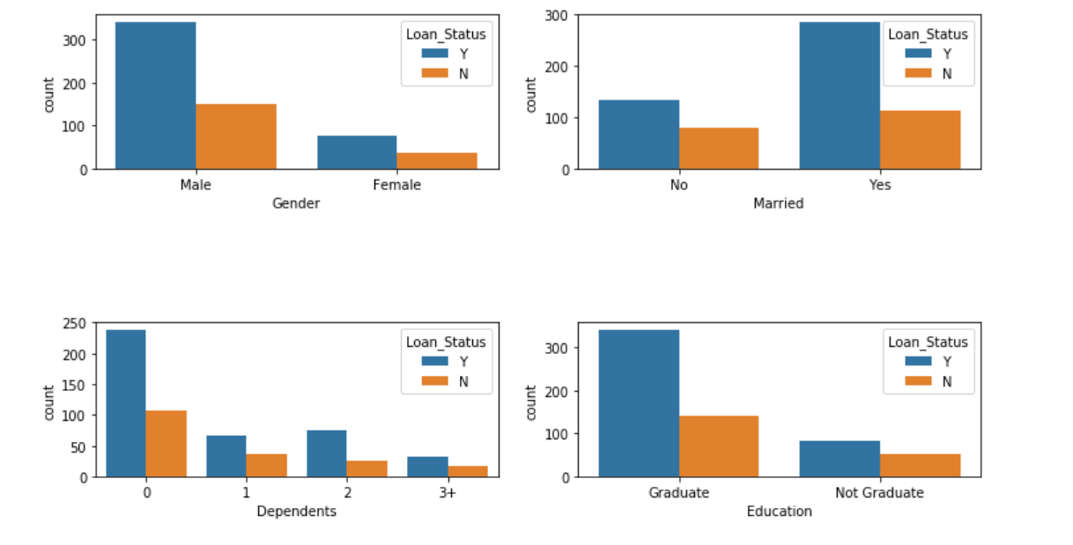
Categorical Plots

Slide 9
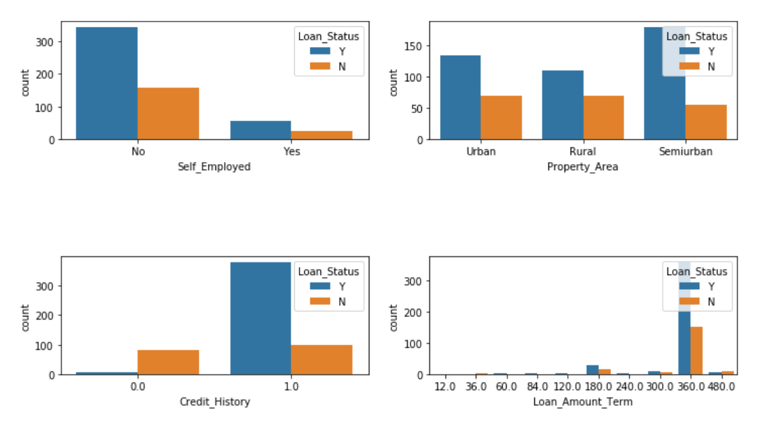
Categorical Plots Continued..

Slide 10
Observations on Plots
Gender: There are around 300 Men and 100+ Women in the dataset.
Marital Status: Around 65% of the population in the dataset is Marred. Also, married applicants are more likely to be granted loans.
Dependents: Most of the loan applicants have zero dependents and are also likely to accepted for loan.
Education: About 80% of the population is Graduate and graduates have higher probability of loan approval
Employment: 80% of population are not self employed.
Property Area: Majority applicants are from Semi-urban and also likely to be granted loans.
Credit_History: Applicants with credit history are far more likely to be accepted.
Loan Amount Term: Majority of the loans taken are for 360 Months (30 years).

Slide 11
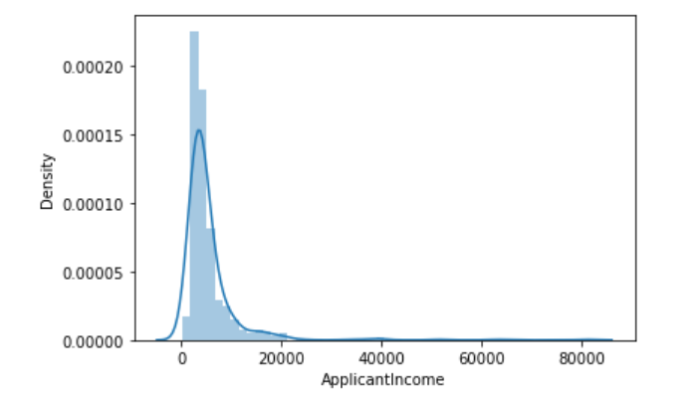
Distribution of Annual Income
Income distribution is right-skewed, most of the applicant's annual income is below $20000

Slide 12
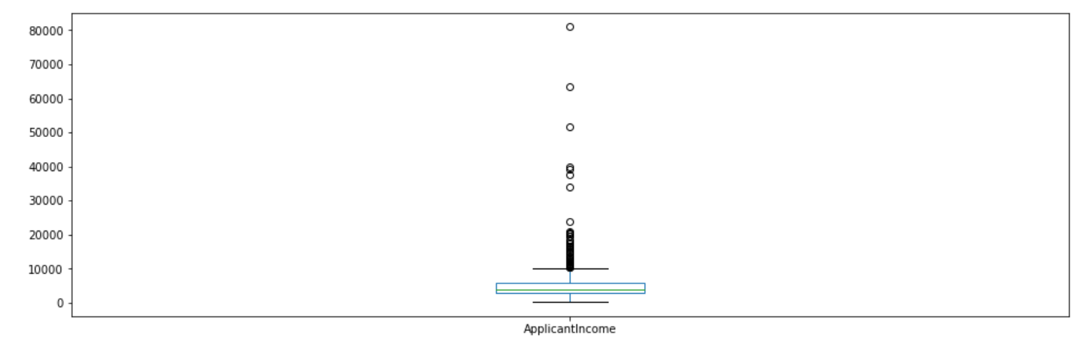
Outlier Detection
From the above boxplot, it’s clear that there are outliers in the data, it is due to income disparity in the society.

Slide 13
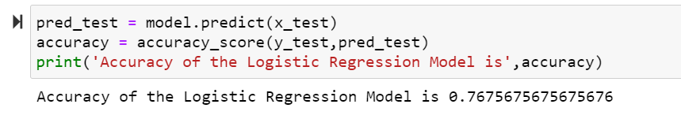
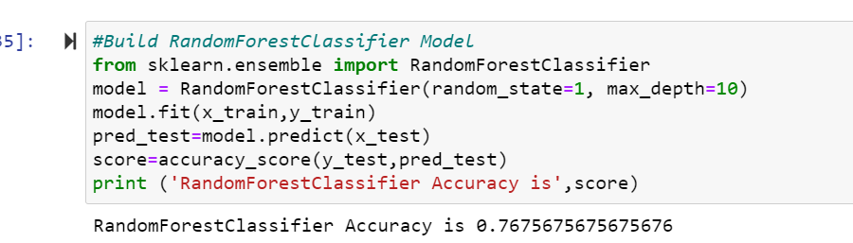
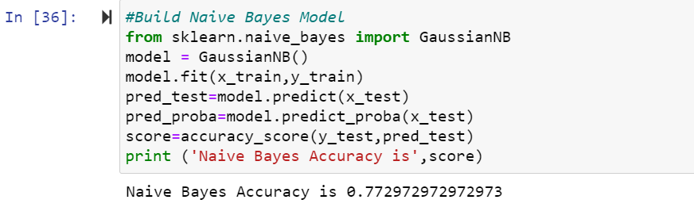
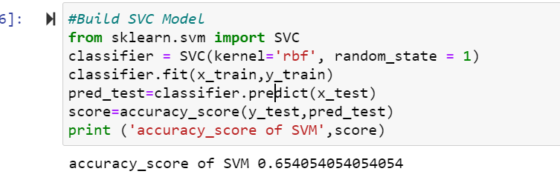
Model Building
Below are four models build
Logistic Regression
Randomforest
Naïve Bayes
SVM
Logistic Regression
Random Forest
Naïve Bayes
SVM

Slide 14
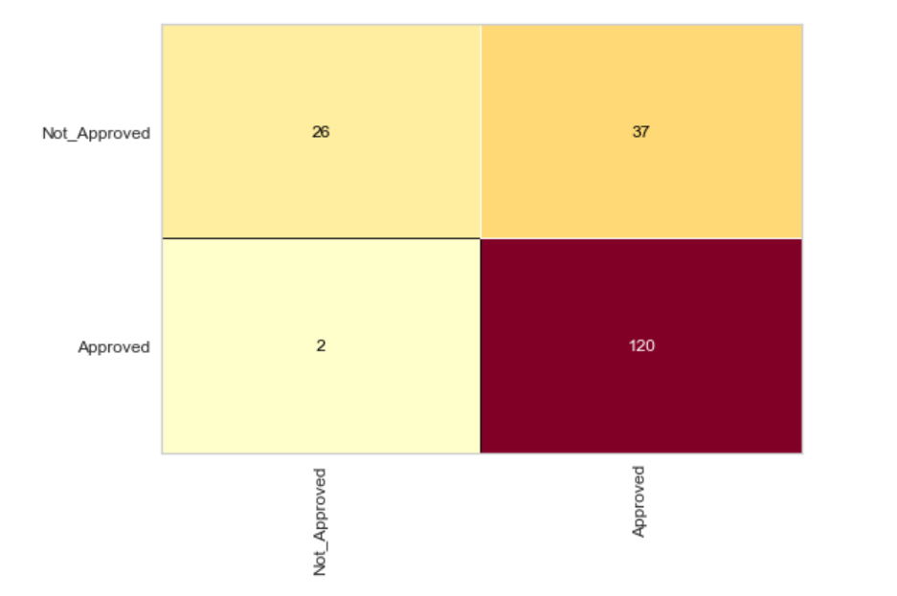
Confusion Matrix

Slide 15
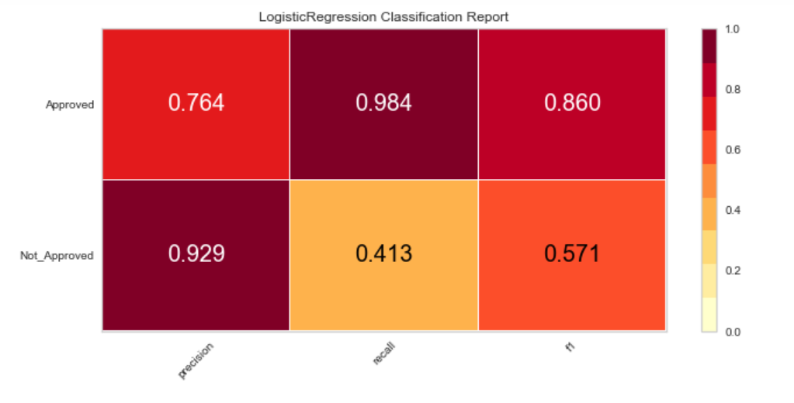
Classification Report
Chart shows the good precision and recall values and f1score 0.860 for approved cases indicates that model is performing as expected

Slide 16
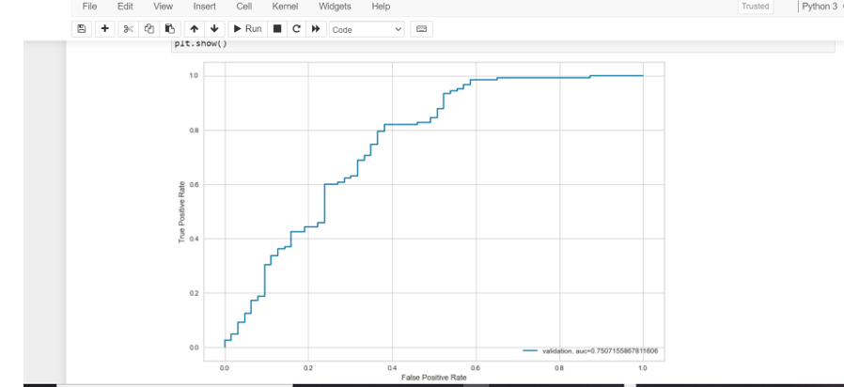
Area Under the Curve (AUC)
Area under the curve is 0.75 indicates that model is reliable

Slide 17
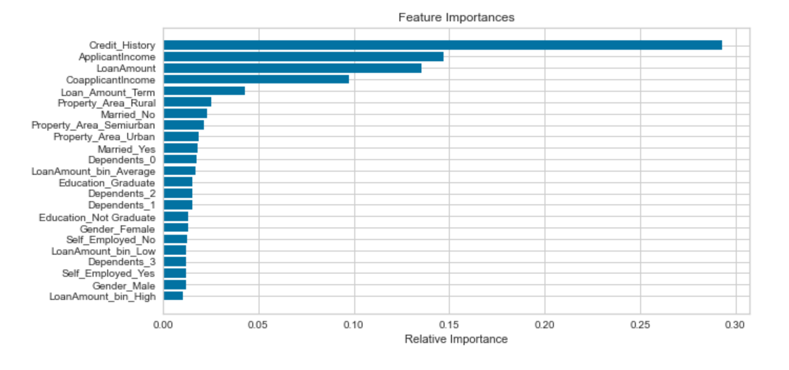
Feature Importance
Above chart shows that credit history is most important factor in deciding the loan application followed by applicant income and loan amount

Slide 18
References
https://www.kaggle.com/premptk/loan-approval-prediction-model/data?select=LoanApprovalPrediction.csv
https://medium.com/@rahulshuklawork/prediction-of-loan-approval-with-machine-learning-539cbd2aad31

